Slide 1
Analyzing Tyrese Maxey’s 3-point Performance
Marcel Allen Jr
12/10/2025
BSAN-360-001
GitHub Repository:

Slide 2
Introducing my data set
Datasets: Tyrese Maxey Game Logs
Files Used (Excel): 5 seasons of Tyrese Maxey regular-season game logs (2020–21 through 2024–25)
Source: Basketball-Reference
Dataset Link: https://www.basketball-reference.com/players/m/maxeyty01/gamelog/2021
Overall size (cleaned data):
400 rows (Dates of Games Played)
17 columns (Performance Metrics)

Slide 3
Cleaned Data Overview
Columns Collected:
Season
Location
Opponent
Score
Win or Loss
GS (Games Tyrese Started)
3P (3 Points Made Per Game)
3PA (3 Points Attempted Per Game)
3P% (What Percentage Tyrese Made Per Game)
PTS (Points Score Per Game)
Team Score
Opponent Score
Why Did I collect these variables?
I chose to collect these variables because together they capture when the game was played, the context of the game, and how Maxey performed. The game information (season, location, opponent, score, team score, opponent score, win or loss, and games started) provides overall context. The shooting and scoring variables (3P, 3PA, 3P%, and PTS) summarize his production and efficiency from the three. Collecting all of these allows me to explore patterns in his performance across different situations.

Slide 4
Descriptive statistics
The original data set includes every regular-season game the Sixers played during Maxey’s career. For this project, I focus on the subset of games in which he attempted at least one three-pointer.
Sixers games per season in data set:
2020–21: 72 games
2021–22: 82 games
2022–23: 82 games
2023–24: 82 games
2024–25: 82 games
Games where Maxey attempted at least one 3:
2020–21: 61 games
2021–22: 75 games
2022–23: 60 games (missed 22 games – injury)
2023–24: 70 games (missed 12 games – injury)
2024–25: 52 games (missed 30 games – injury)

Slide 5
Research Questions
Research Question 1: Seasons
Are there differences in Maxey’s 3P% across seasons?
H₀: Maxey’s mean 3P% is the same in every season
H₁: At least one season has a different mean 3P%
Research Question 2: Conferences
Does Maxey’s three-point efficiency differ between Eastern and Western Conference opponents?
H₀: Maxey’s mean 3P% vs Eastern Conference teams equals his mean 3P% vs Western Conference teams
H₁: Maxey’s mean 3P% differs between Eastern and Western Conference opponents
Research Question 3: Career trend
Has Maxey’s three-point percentage improved, declined, or remained consistent over his career?
H₀: There is no trend in Maxey’s 3P% across seasons
H₁: Maxey’s 3P% shows a trend over seasons

Slide 6
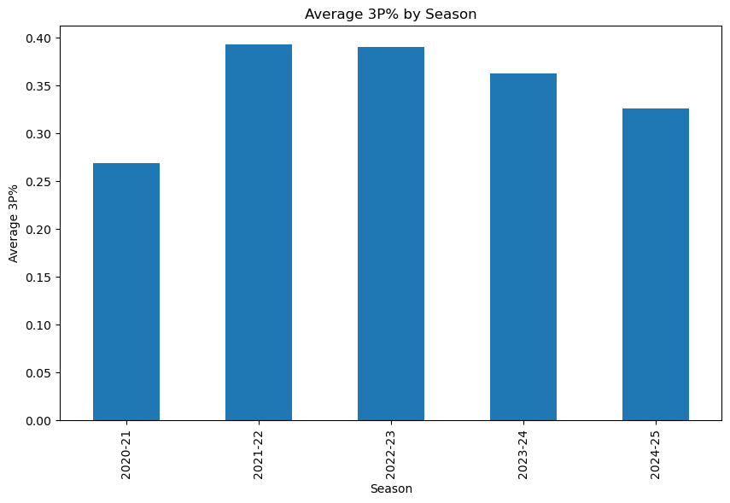
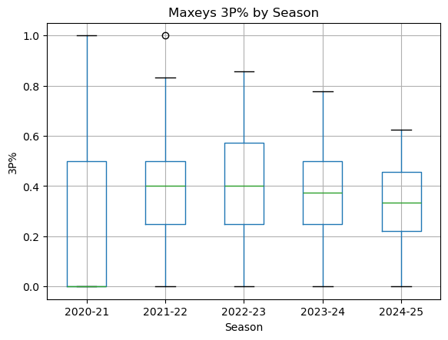
Research Question 1: Seasons
Average 3P% peaks in 2021–22 and 2022–23, then declines slightly in 2023–24 and 2024–25
ANOVA indicates significant differences in mean 3P% across seasons (F = 2.56, p ≈ 0.039), so we reject H₀ that all seasons are identical.
R squared is small (η² ≈ 0.03), meaning season-to-season differences only explain a small portion of his overall 3P% variation

Slide 7
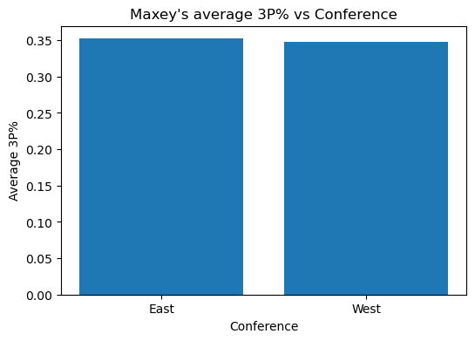
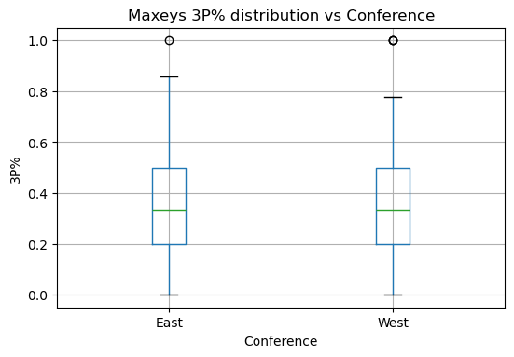
Research Question 2: Conferences
Maxey’s average 3P% vs Eastern Conference teams is very similar to his average vs Western Conference teams
The conference ANOVA is not statistically significant (p ≈ 0.89), so we fail to reject H₀: there is no evidence of a conference-based difference in his 3P%
Maxey’s three-point efficiency is consistent regardless of conference

Slide 8
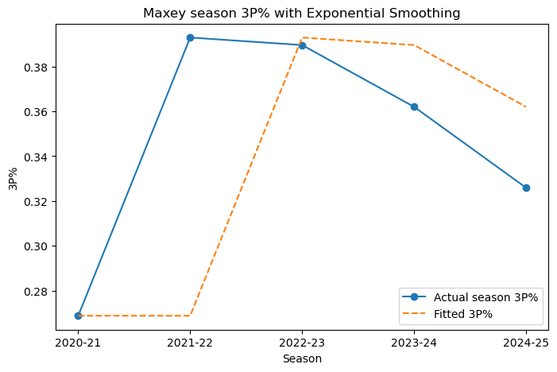
Research Question 3: Career trend
Season averages show a big jump in 3P% from 2020–21 to 2021–22, followed by very similar efficiency in 2021–22 and 2022–23
After 2022–23, his 3P% declines slightly in 2023–24 and again in 2024–25, even as his shot volume increases.
The exponential smoothing line rises sharply early in his career and then slopes gently downward, suggesting no strong upward trend in recent seasons
There are many possible reasons for the small dip in the last two seasons, things like role change, increased volume, or injuries, but this analysis doesn’t directly test those explanations

Slide 9
Conclusion

